Slide 1
Diksha patil Roll no : CC29
HOTEL
MANAGEMENT
SYSTEM
USING PYTHON

Slide 2
Abstract
The Hotel Management System is a simple Python project made to handle hotel work easily.
It helps to manage room bookings, restaurant orders, payments, and customer records in one place.
The system provides an easy-to-use web interface that saves time, reduces mistakes, and makes hotel management faster and smoother.
Introduction
In today’s digital world, managing a hotel manually is time-consuming and can cause errors. This project automates key hotel tasks like room booking, customer record keeping, payment processing, and restaurant order management. Built with Python, the system provides an easy-to-use web interface for staff to manage all operations efficiently.

Slide 3
Problem Definition
Manual hotel management is time-consuming.
Keeping records by hand can lead to errors and mistakes.
Billing and payment processes are slow and inefficient.
No centralized system exists to manage all hotel operations.
Difficult to track room availability and restaurant orders manually.
Need of the System
• To reduce manual work and paperwork.
• To maintain accurate and organized customer data.
• To provide faster booking and billing processes.
• To improve customer service and staff efficiency.
• To ensure easy access and retrieval of hotel records.

Slide 4
Objective
• To develop a simple and interactive hotel management web application.
• To manage room bookings, restaurant orders, and payments digitally.
• To store customer details and records in a database securely.
• To reduce human errors and improve operational speed.
• To design a beginner-friendly system using Python and Flask.
Scope of the Project
The system is ideal for small and medium-sized hotels or lodges. It can be used for maintaining room availability, customer details, food orders, and payments. The project can be further enhanced by adding features like online booking, invoice generation, and login authentication.

Slide 5
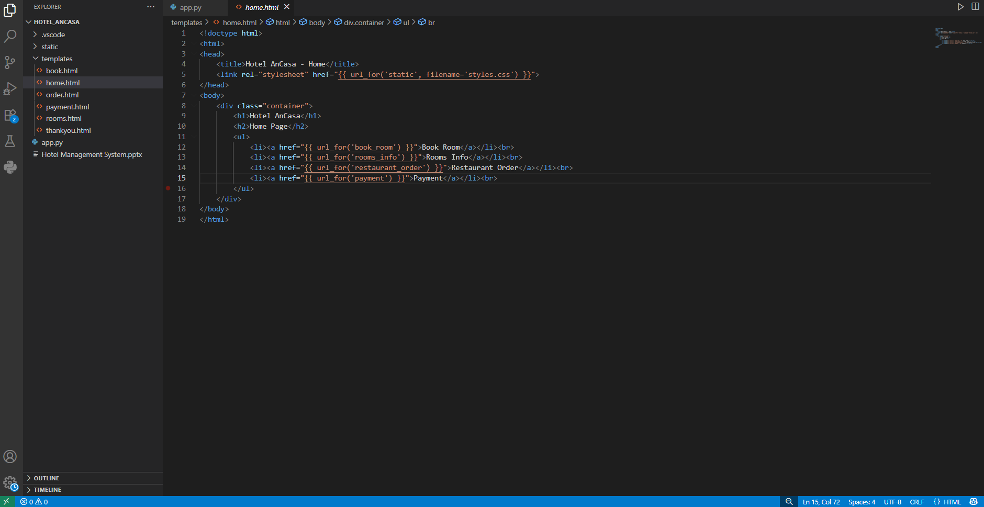
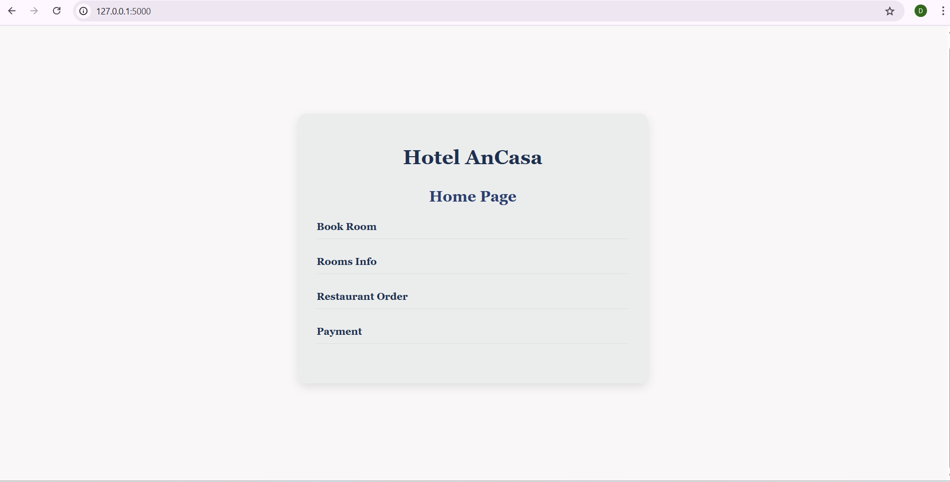
Flow of the Project
1.Home Page – Main menu with navigation options.

Slide 6
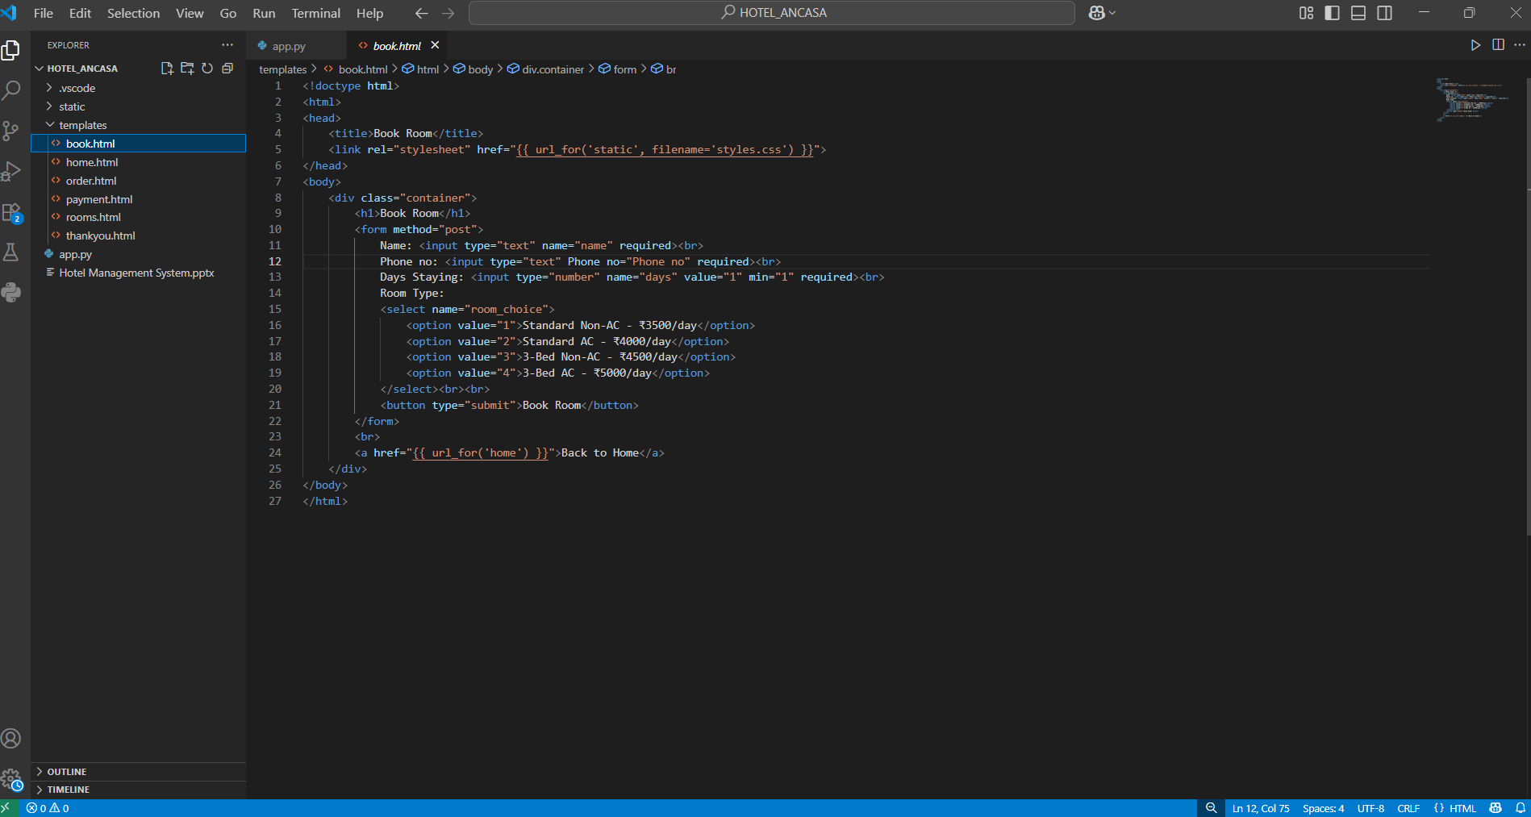
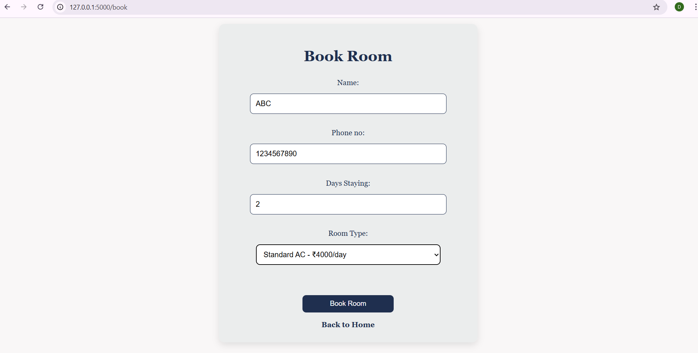
Flow of the Project
2.Booking Page – Customer enters name, contact, Staying days, Room type and Book room

Slide 7
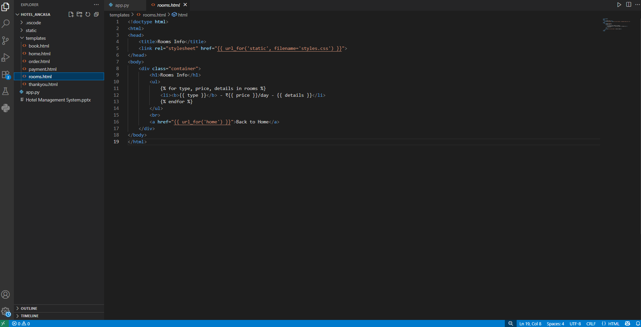
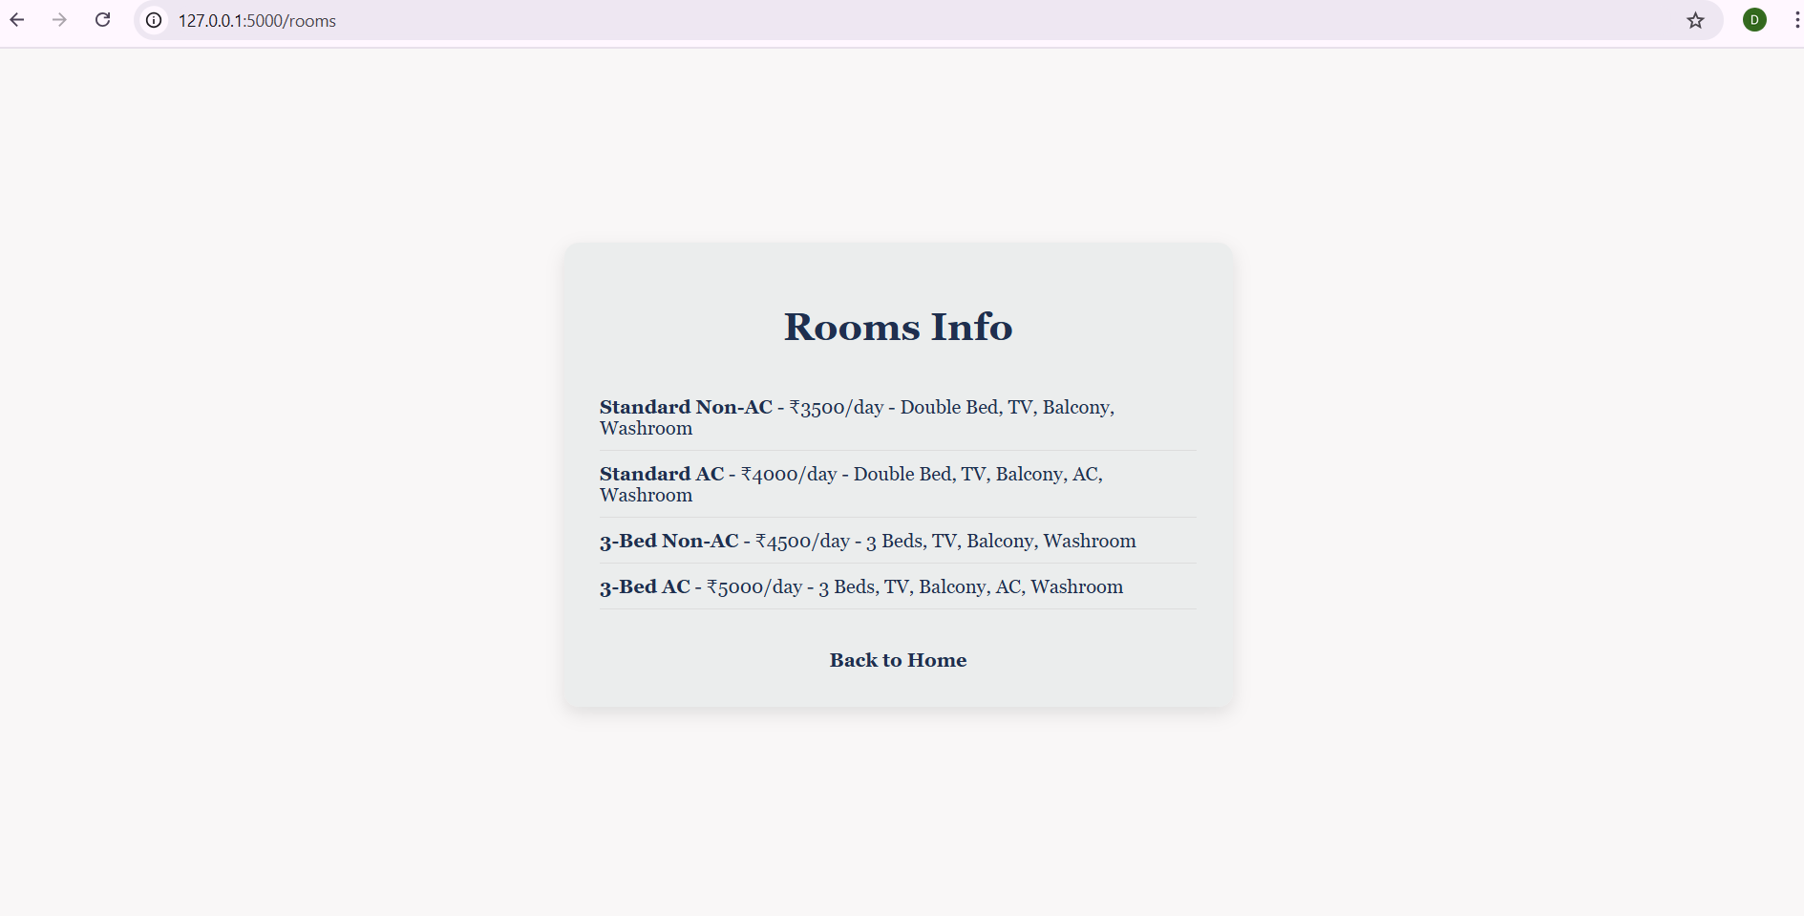
Flow of the Project
3.Room Info Page – Shows available rooms and details.

Slide 8
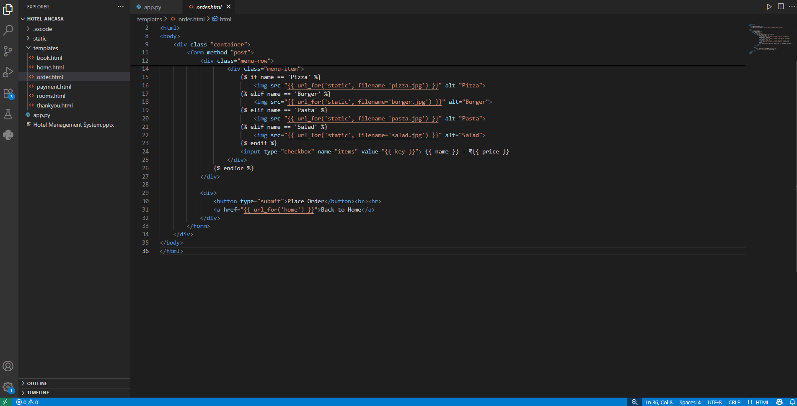
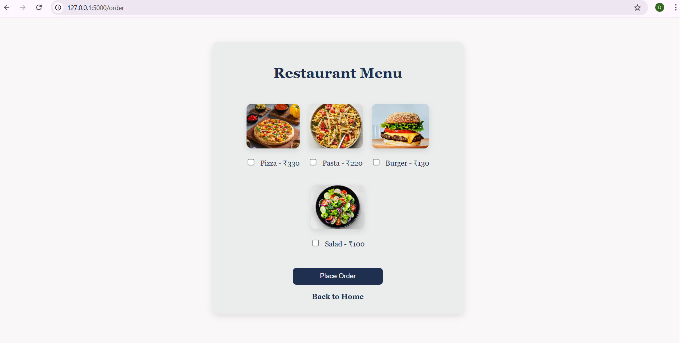
Flow of the Project
4. Restaurant Order Page – Customer orders food items

Slide 9
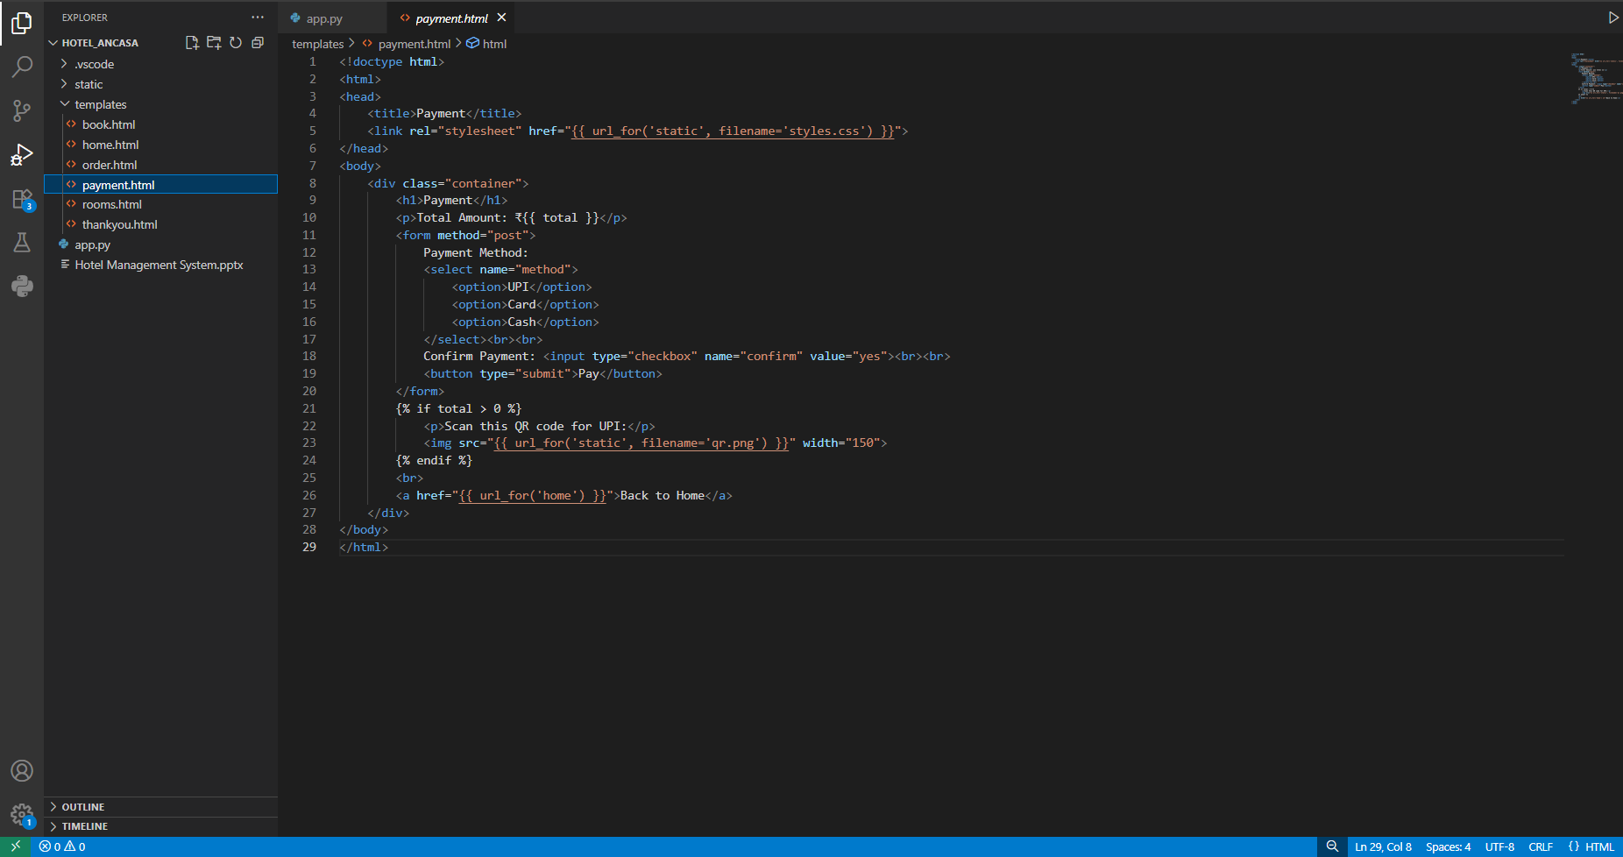
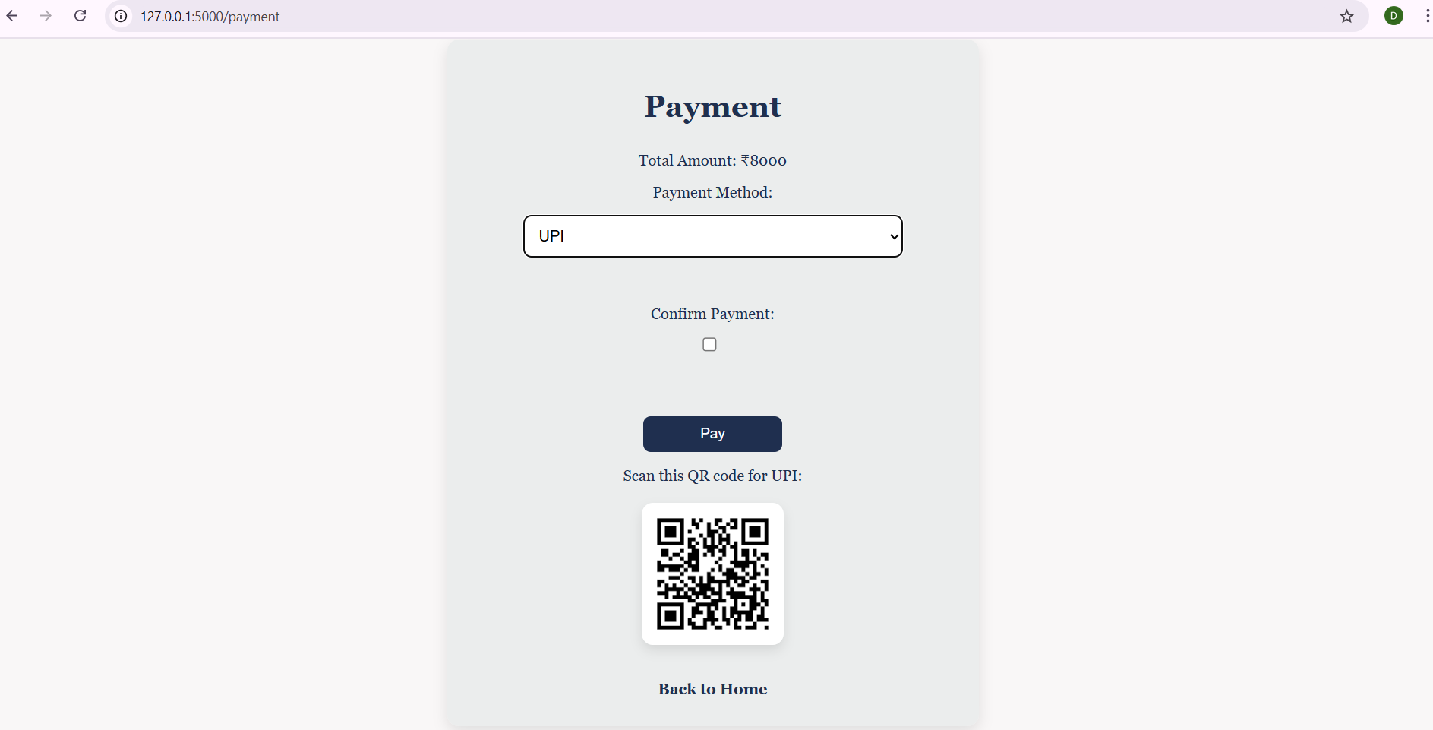
Flow of the Project
5. Payment Page – Displays total bill and accepts payment.

Slide 10
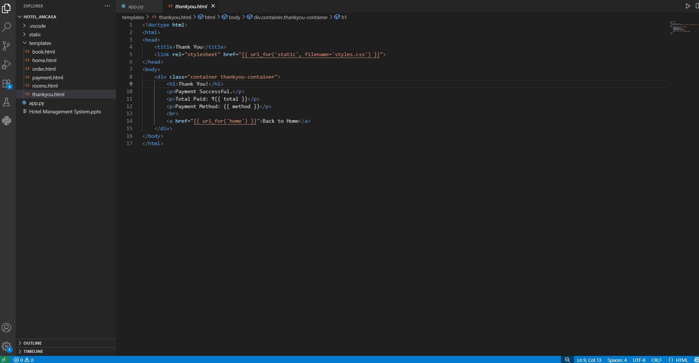
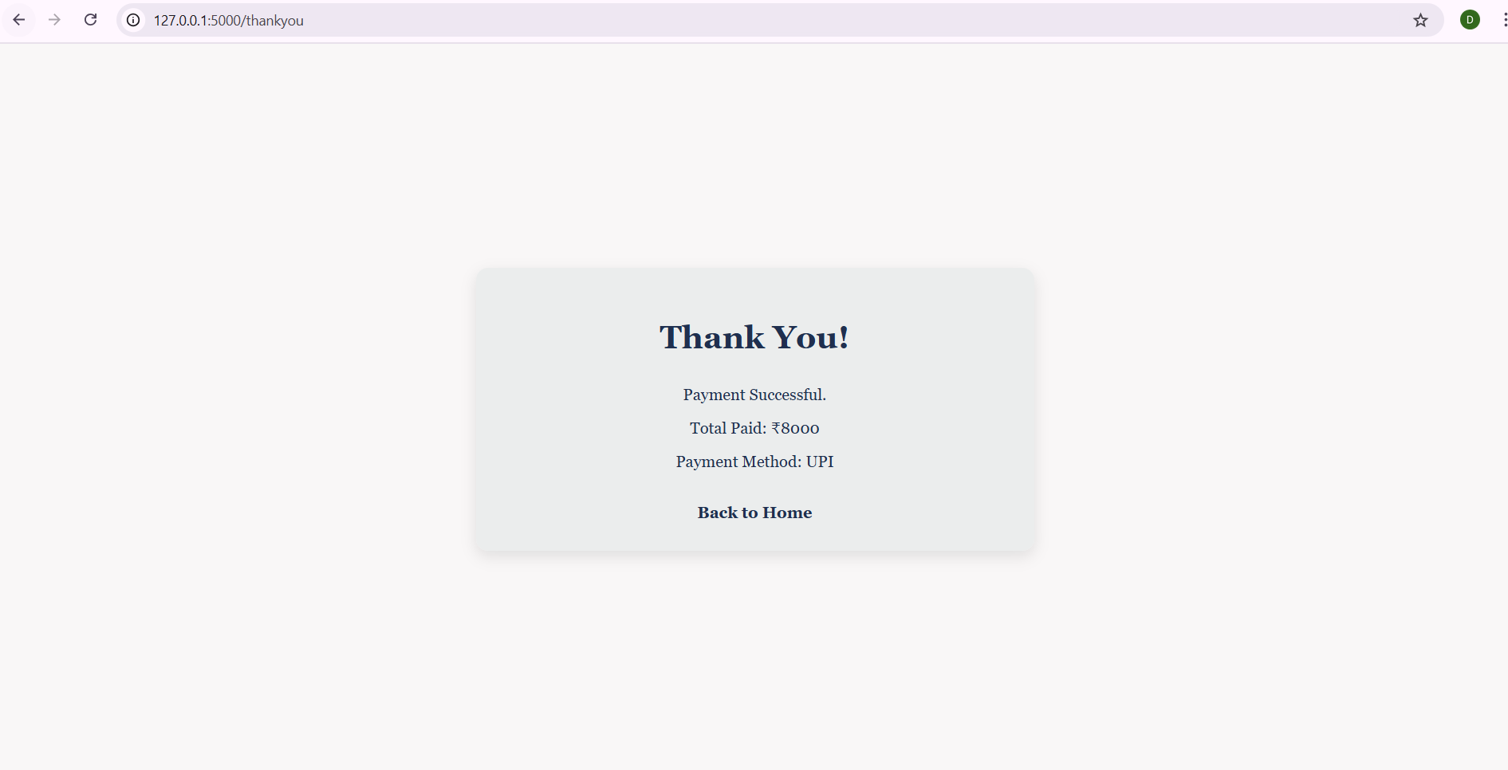
Flow of the Project
6.Thank You Page – Confirms successful booking and food order.

